Slide 1
Testing of Hypothesis
B.SC CSIT 3rd
Semester
Central Campus of Technology

Slide 2
TESTING OF HYPOTHESIS:
Testing of hypothesis is a statistical method of making inference about the population under study from the sample observations by testing a hypothesis whether to reject or to accept. In other words, a statistical test which employed to make decision on the estimates of parameter(s) by testing the reliability or validity of estimation made is called testing of hypothesis.

Slide 3
Procedure of Hypothesis Testing:
Step1: Set up the null hypothesis H₀.
Step2: Set up the alternative hypothesis H₁ against Null hypothesis H_{0.}
Step3: Fix the level of significance (α) to be or 5% or 1% unless stated level of significance is always fixed in advanced before collecting the sample information.
Step4: Compute the test statistic: Under (H₀) or it is also called calculated value.
Step5: Write down the critical or tabulated value of test statistic as pre-determine level of significance
Step6: Make a decision: If the calculated values of test statistics is less than the tabulated value, we accept the null hypothesis. If the calculated value of test statistics is greater than the tabulated value, we reject the null hypothesis.
Step7: Make a Conclusion: Write the statement of accepted hypothesis(H₀)

Slide 4
Null Hypothesis:
The hypothesis which is set up such that there is no significance difference between true value and expected value of the parameter, then the hypothesis is called null hypothesis.
Null hypothesis is also called the hypothesis of no difference. Null hypothesis is generally denoted by H₀ and we write. H₀: µ=µ₀

Slide 5
Alternative Hypothesis:
A hypothesis which is complementary to the null hypothesis is called an alternative hypothesis. Any hypothesis which is not null is also called alternative hypothesis. It is hypothesis of difference between sample statistic and parameter. It is hypothesis of difference between parameters.
Alternative hypothesis is denoted by H₁. Alternative hypothesis are
Two tailed test: H₁: µ ≠µ₀
One tailed test(Right tailed test): H₁: µ > µ₀
One tailed test (Left tailed test) : H₁: µ < µ₀

Slide 6
Identification of One Tailed and Two tailed Test.
Generally, if direction of difference is not given in the statement of hypothesis, then we use two tailed test. Similarly if the direction of difference like at least, at most, increase, decrease, majority, minority, larger, taller, high, low, superior, inferior, improved, more than, less than, over, under, below, sliently, claim, better, effective, enhance, positively biased, negatively biased is included in the statement of hypothesis ,then we use one tailed test etc.

Slide 7
Note:
The right tail and left tailed has been identified by the following way.
If sample statistics > population parameter, then we used right tailed test.
If sample statistics < population parameter, then we used left tailed test

Slide 8
p-Value (Probability Value)
p-value approach is another method for testing of statistical hypothesis. A p-value conveys much information about the strength of evidence against H₀ and allows an individual decision maker to draw a conclusion at any specified level α. The decision will be made by comparing the p-value with pre-fixed value of α. If p-value ≤ α, reject H₀ at α level of significance but if p-value > α then H₀ is accepted.
For one tailed tests
If p-value i.e. p₀ ≤ α, then reject H₀ otherwise accept H_{0.}
For two tailed tests
If p-value i.e 2p₀ ≤ α then H₀ is rejected otherwise H₀ is accepted.
For Z test, p value = Probability( Z ≥ |Zcalculated|)

Slide 9
Degrees of Freedom:
Degree of freedom refers to the number of values in a sample that can be chosen freely. In other words, a degree of freedom represents the number of observations that remains unspecified. Degree of freedom is denoted by nu(v). In some case, degree of freedom is also determined as the sample size minus the number of population parameters that are estimated from sample observations.
Degree of freedom= No. of sample observation- No. of Specified Observation

Slide 10
Errors in Hypothesis Testing
Type I error
The rejection of null hypothesis when it is true is called type I error i.e. if the null hypothesis H₀ is rejected, it is said to be type I error. The probability of type I error is denoted by α. This α is also known as the critical region.
α = P { Type I error }
= P { Reject H₀ when H₀ is true}
Type II error
If the false null hypothesis H₀ is accepted, it id said to be type II error i.e the acceptance of null hypothesis when it is false is called type II error. The probability of type II error is denoted by β.
β = P { Type II error}
= P { Accept H₀ when H₀ is false}

Slide 11
Decision Table
The corrected decision and the two types of errors committed in testing the hypothesis are shown in the following table.
Action or Decision | State of nature
 | H₀ is true | H₀ is false
Reject H₀ | Type I error | Correct decision
Accept H₀ | Correct decision | Type II error

Slide 12
Power of test (1-β)
The probability of rejecting H₀ when H₀ is false is probability of correct decision is called power of test and is denoted by 1-β. It is also called probability of accepting H₁ when H₁ is true. It is the probability of not making type II error.
Power of test = P{Reject H₀ when H₀ is false}
= 1- P{ Accept H₀ when H₀ is false }
= 1 – P{ Type II error}
= 1-β

Slide 13
Level of Significance
Probability of rejecting null hypothesis H₀ when it is true is called level of significance . In other words , level of significance is the probability of type I error or the size of the critical region. The level of significance is therefore denoted by α. Commonly used level of significance are 1%, 5%, 10%.

Slide 14
Critical Region
It is also called the rejection region. The set of all possible values of statistics is divided in to two region one leading to the rejection of H₀ and other to the acceptance of H₀. The division is made on the basis of level of significance and alternative hypothesis. The region which leads to the rejection of null hypothesis is called rejection region and is denoted by W. While those region which leads to the acceptance of null hypothesis is called acceptance region and is denoted by W-S.

Slide 15
Z-Test (Large Sample test)
Z test is one of important parametric tests which are based on the assumption of normality and the samples: n is more than 30. So it is called large samples test and population variance is known and sample drawn are in dependent and normally distributed. It is introduced by R.A Fisher.
Assumptions of Z- test
The Z- test is used under the following assumptions:
The sample size is large i.e n≥30.
The population from which the samples are drawn is normally distributed.
The population standard deviation (σ) is known.
The samples are independent.

Slide 16
Case I: Test of significance of Single Mean
Step1: Null Hypothesis (H₀) : µ=µ₀ i.e the population mean is equal to the specified mean µ₀ or there is no significant difference between the sample mean( x̅) and population mean( µ).
Step2: Alternative hypothesis (H₁) : µ ≠µ₀ i.e the population mean is equal to the specified mean µ₀ or there is significant difference between the sample mean( x̅) and population mean( µ).
H₁ : µ > µ₀ i.e the population mean is greater than the specified mean (µ₀) (Right tailed test)
H₁ : µ < µ₀ i. the population mean is less than the specified mean (µ₀) (Left tailed test)

Slide 17
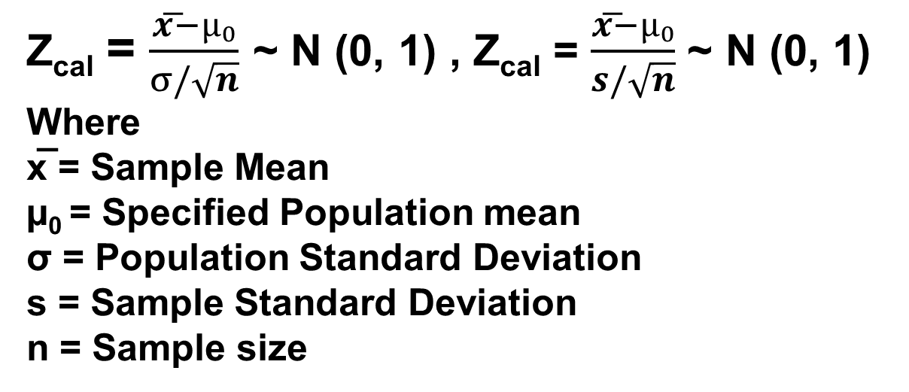
Step3: Test statistics: Under H₀
Z_{cal} = $\frac{x͞−µ₀}{σ/\sqrt{n}}$ ~ N (0, 1) , Z_{cal} = $\frac{x͞−µ₀}{s/\sqrt{n}}$ ~ N (0, 1)
Where
x̅ = Sample Mean
µ₀ = Specified Population mean
σ = Population Standard Deviation
s = Sample Standard Deviation
n = Sample size
Step 4: Level of significance (α) : Usually we take α = 5% unless we are given.

Slide 18
Critical Value and Decision
Step 5: Tabulated or Critical value : Set up the critical value or tabulated value of Z as per the level of significance used and alternative hypothesis.
Step 6: Decision:
If calculated value of |Z|(Z_{cal}) > tabulated value of |Z|(Z_{tab}) , H₀ is rejected i.e H₁ is accepted as the statistics falls in to the rejection region.
If calculated value of |Z|(Z_{cal}) ≤ tabulated value of |Z|(Z_{tab}) , H₀ is accepted i.e H₁ is rejected as the statistics falls in to the acceptance region.

Slide 19
Case-I : Test of Significance of Single Population Mean
A sample of 64 glass rods was taken from a lot manufactured under a new process and tested for their breaking strength. The mean breaking strength of the sample was found to be 20 kgs and standard deviation 4 kgs. Test the hypothesis that the average breaking strength of glass rod is 24 kgs. Use 5% level of significance.
At a particular bank branch the expected mean amount of money withdraw from ATM’s per customer transaction over the weekend is Rs. 2500 with an estimated standard deviation of Rs 600. A random sample of 64 customers transaction is examined and the sample mean withdrawl from ATM is found to be Rs. 3200. From the data can you conclude at 1% level of significance that the sample average is higher than expected?

Slide 20
Case-I : Test of Significance of Single Population Mean
A random sample of boots worn by 40 combat soldiers in a desert region showed an average life of 1.08 years with a standard deviation of 0.05 years. Under the standard conditions the boots are known to have an average life of 1.28 years. Is there reason to assert at a level of significance 0.05 that use in the desert causes the mean life of such boots to decrease?
The Nepal bulb company claims that the bulb has average life of 15000 hrs. with standard deviation of 1200 hrs. However, there has been complaint against this claim from the regular customers that a sample 60 bulbs has average life of only 13000 hrs. Can you justify this claim at 5% level of significance?

Slide 21
Problems:
A sample of 400 male students is found to have a mean height of 171.38cm. Can it be reasonably regarded as a sample from a large population with mean height 171.17 cm and standard deviation 3.30 cm? Use p-Value.

Slide 22
Case II: Test of significance of Difference between Two Means
Null Hypothesis (H₀) : µ₁ = µ₂ i.e two population means are equal or there is no significant different between the two sample means.
Alternative Hypothesis (H₁) : µ₁ ≠ µ₂ i.e two population means are not equal or there is significant different between the two sample means (Two tailed test)
H₁ : µ₁ > µ₂ i.e the mean of first population is greater than the mean of the second population (Right tailed test)
H₁ : µ₁ < µ₂ i.e the mean of first population is less than the mean of the second population (Left tailed test)

Slide 23
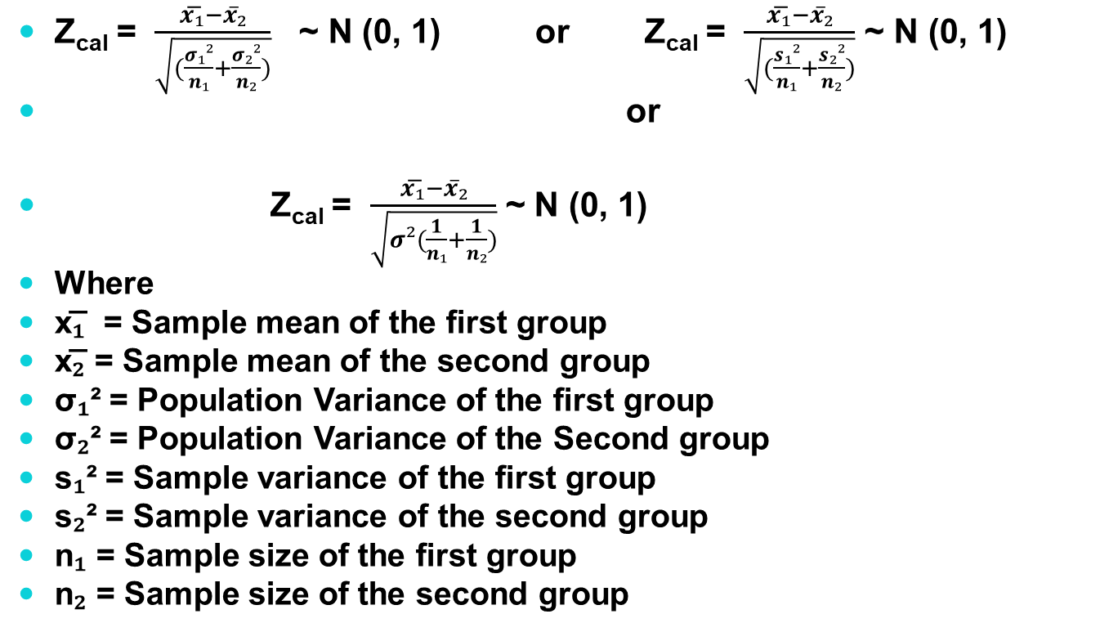
Test Statistc: Under H0
Z_{cal} = $\frac{x͞₁−x̅₂}{\sqrt{(\frac{σ₁²}{n₁}+\frac{σ₂²}{n₂})}}$ ~ N (0, 1) or Z_{cal} = $\frac{x͞₁−x̅₂}{\sqrt{(\frac{s₁²}{n₁}+\frac{s₂²}{n₂})}}$ ~ N (0, 1)
or
Z_{cal} = $\frac{x͞₁−x̅₂}{\sqrt{σ²(\frac{1}{n₁}+\frac{1}{n₂})}}$ ~ N (0, 1)
Where
x͞₁ = Sample mean of the first group
x͞₂ = Sample mean of the second group
σ₁² = Population Variance of the first group
σ₂² = Population Variance of the Second group
s₁² = Sample variance of the first group
s₂² = Sample variance of the second group
n₁ = Sample size of the first group
n₂ = Sample size of the second group

Slide 24
Problems
Electric bulbs manufactured by X and Y companies gave the following results:
 | X Company | Y Company
No. of bulbs used | 100 | 100
Mean life in hours | 1300 | 1248
Standard deviations | 82 | 93
Test whether there is any significant difference in the mean life of the two makes.
2. A company claims that its light bulbs are superior to those of the competitor on the basis of a study which showed that a sample of 40 of its bulbs had an average life time 628 hour of continuous use with a standard deviation of 27 hours. While sample of 30 bulbs made by the competitor had an average life time of 619 hours of continuous use with a standard deviation of 25 hours. Test at 5% level of significance , whether this claim is justified.

Slide 25
Problems:
3. A consumer – research organization routinely selects several car models each year and evaluates their fuel efficiency. In this year’s study of two similar subcompact models from two different automakers, the average gas mileage for 40 cars of brand A was 37.2 miles per gallon (mpg), and the standard deviation was 3.8 mpg. The 50 brand B cars that were tested averaged 32.1 mpg, and the standard deviation was 4.3 mpg, At α = 0.01, Should it conclude that brand A cars have higher average gas mileage than that of brand B.

Slide 26
Problems:
A random sample of 1000 workers from Pokhara show that their mean wages of $ 47 per week with a standard deviation $ 28 . A random sample of 1500 workers from Kathmandu show that their mean wage $ 49 per week with a standard deviation of $ 40. Is there any significant difference between their mean level of wages. Use p value method at 5% level of significance.

Slide 27
Case III: Test of significance of a Single Proportion
Step 1: Null Hypothesis(H₀) : P=P₀ i.e the population proportion has specified proportion P₀ or there is no significant difference between the sample proportion (p) and Population (P)
Step 2: Alternative Hypothesis (H₁) : P≠P₀ i.e the population proportion is not equal to specified proportion P₀ or there is significant difference between the sample proportion (p) and Population (P)
H₁: P>P₀ i.e the population proportion is greater than specified proportion P₀ (Right tailed test)
H₁: P<P₀ i.e the population proportion is less than specified proportion P₀ (Left tailed test)

Slide 28
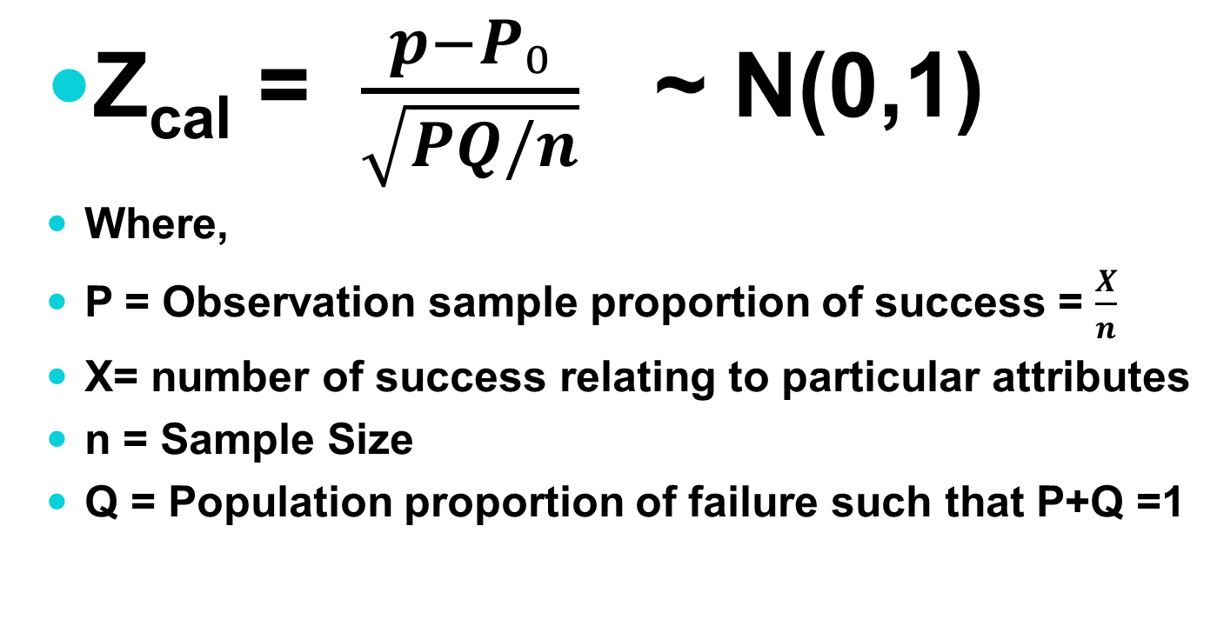
Test statistics: Under H₀
Z_{cal} = $\frac{p−P₀}{\sqrt{PQ/n}}$ ~ N(0,1)
Where,
P = Observation sample proportion of success = $\frac{X}{n}$
X= number of success relating to particular attributes
n = Sample Size
Q = Population proportion of failure such that P+Q =1

Slide 29
Problems:
A coin is tossed 800 times and heads appear 480 times. Can you infer that the coin is unbiased at 1% level of significance?
A sample of 600 persons selected randomly from a large city gives the result that males are 53%. Is there reason to doubt the hypothesis that males and females are in equal number in the city?
In a sample of 400 water tanks it was found that 30 water tanks were defective. The company which produces these water tank claims only 5% of their water tanks are defective. Test the claim of the company at 5% level of significance.
It is claimed that both tea and coffee are equally popular in Ilam district. If in a random sample of 1200 persons 650 were regular consumers of tea. Is the claim justified at 5% level of significance?

Slide 30
Problems:
A member of public interest group concerned with environment pollution assert at public hearing that “ fewer than 60% of the industrial plants in this area are complying with air pollution standards”. The officials samples 60 plants and finds that 33 are complying with air pollution standards. Is the asserting by the member of public interest group a valid one? Test the hypothesis at 0.02 significance level.

Slide 31
CaseIV: Test of Significance for Difference of Two Proportions:
Null hypothesis(H₀) : P₁=P₂ i.e two population proportion are same or there is no significant difference between two population proportions.
Alternative Hypothesis(H₁): P₁≠P₂ i.e two population are not same or there is significant difference between two population proportions.(Two tailed test)
H₁: P₁>P₂ i.e the population proportion of first group is greater than second group (Right tailed test)
H₁: P₁<P₂ i.e the population proportion of first group is less than second group (Left tailed test).

Slide 32
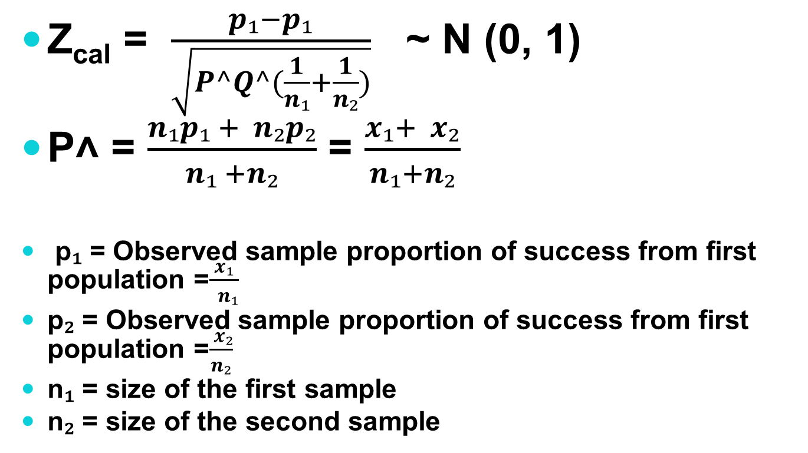
Test statistics: Under H₀,
Z_{cal} = $\frac{p₁−p₁}{\sqrt{P^Q^(\frac{1}{n₁}+\frac{1}{n₂})}}$ ~ N (0, 1)
P˄ = $\frac{n₁p₁ + n₂p₂}{n₁ +n₂}$ = $\frac{x₁+ x₂}{n₁+n₂}$
p₁ = Observed sample proportion of success from first population =$\frac{x₁}{ n₁}$
p₂ = Observed sample proportion of success from first population =$\frac{ x₂}{n₂}$
n₁ = size of the first sample
n₂ = size of the second sample

Slide 33
Problems:
Random samples of 250 bolts manufactured by machine A and 200 bolts manufactured by machine B showed 24 and 10 defective bolts respectively. Test the hypothesis that the machines are showing different qualities of performance. Use 5% level of significance.
Before an increase in excise duty on cigarette, 400 out of a sample of 500 persons were smokers. After the increase in excise duty 400 out of a sample of 600 persons were found to be smokers. Was the observed decrease in proportion of smokers significant?
The records of hospital show that 52 men in a sample of 1000 men versus 23 women in a sample of 1000 women were admitted because of heart disease. Do these data present sufficient evidence to indicate higher rate of heart disease among men admitted to the hospital? Use α = 0.05.

Slide 34
Short Cut Key for Critical Value of Z:
Critical Values (Z_{α}) | Level of significance (α)
 | 1% | 5% | 10%
Two tailed test | |Z_{α}|= 2.58 | |Z_{α}|= 1.96 | |Z_{α}|= 1.65
Right Tailed test | Z_{α} = 2.33 | Z_{α} = 1.65 | Z_{α} = 1.28
Left tailed test | Z_{α} = -2.33 | Z_{α} = -1.65 | Z_{α} = -1.28

Slide 35
